Slide 1
Control of a fleet of drones at constant altitude (3 double integrators) and
polynomial trajectory tracking
ARS5 - Final project
Thanh Trung DINH
Vu Hoi HUYNH
Huy Dung NGUYEN

Slide 2
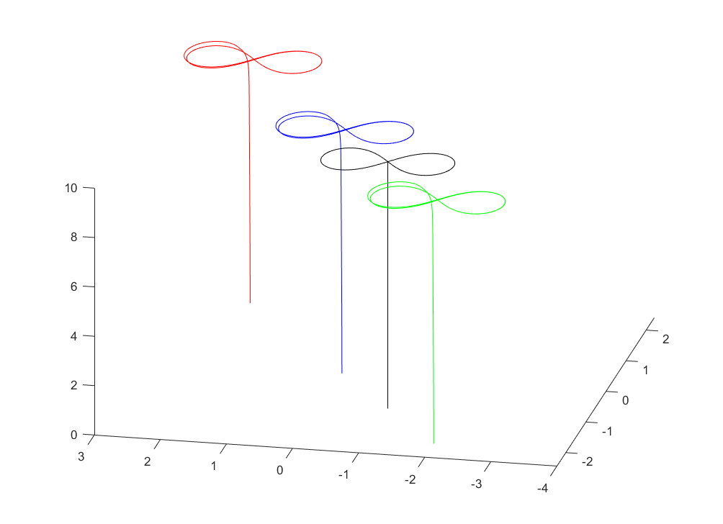
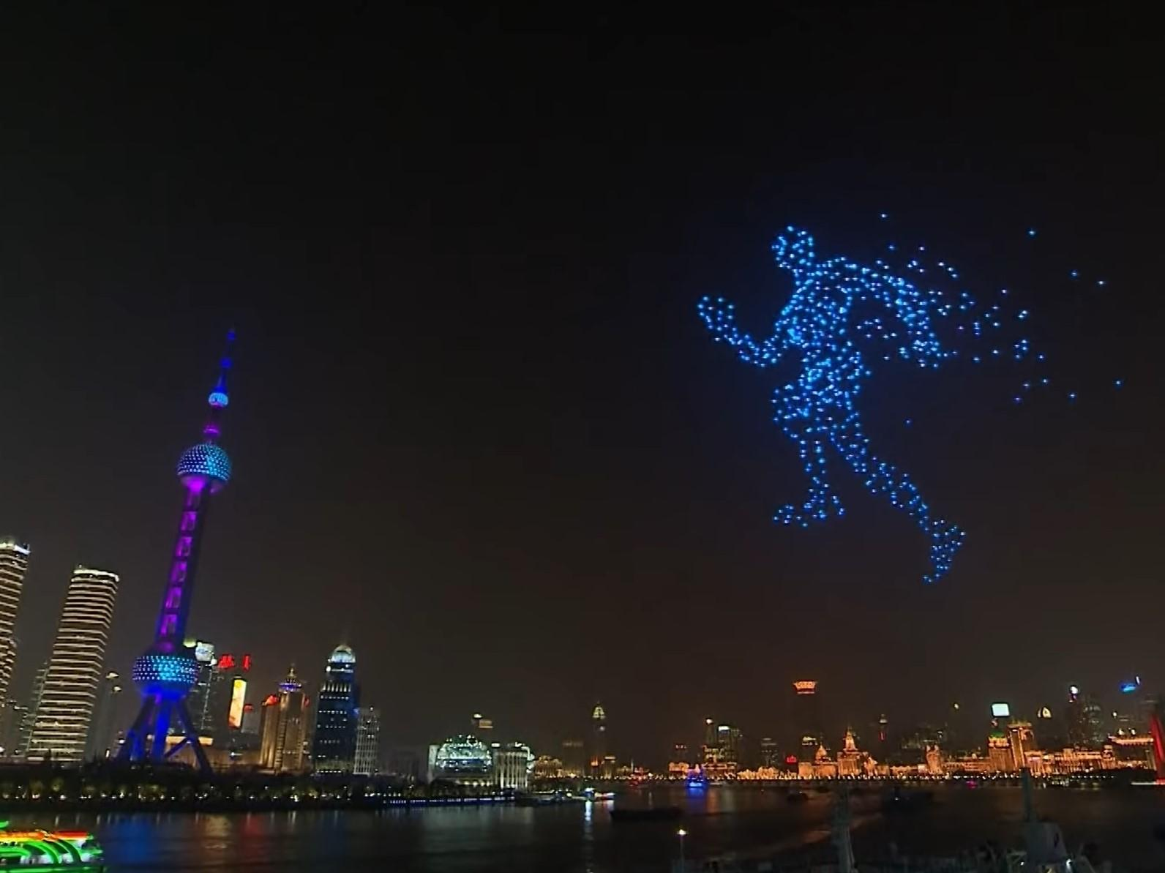
Introduction
New trend in drone control technology
Project: Control fleet of drones and polynomial trajectory tracking

Slide 3
Contents
Control an individual drone
Dynamic model
Controller
Control fleet of drone
Formation control
Fleet of 3 drones
Simulation
Simple system
Path tracking : polynomial trajectory
Conclusion

Slide 4
Control an individual drone

Slide 5
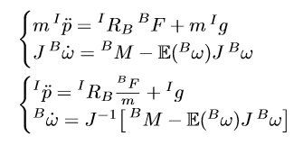
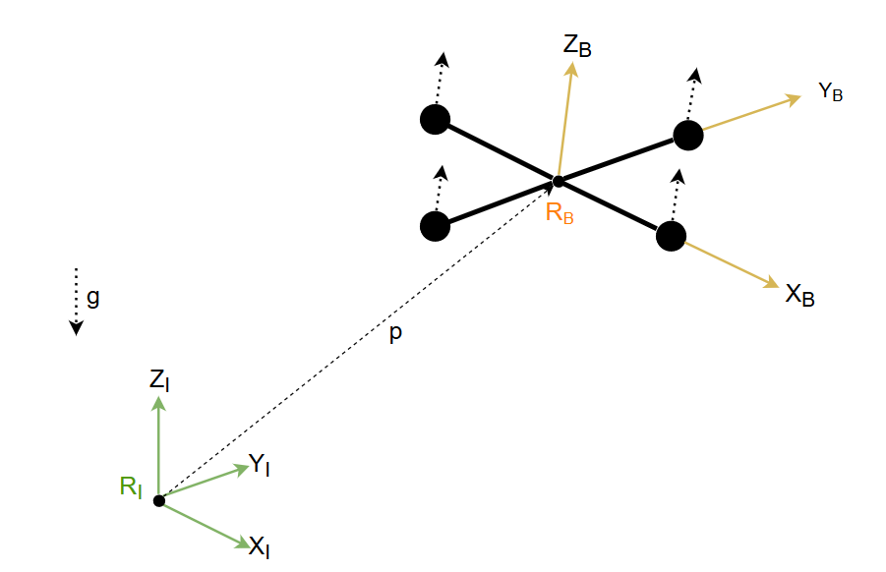
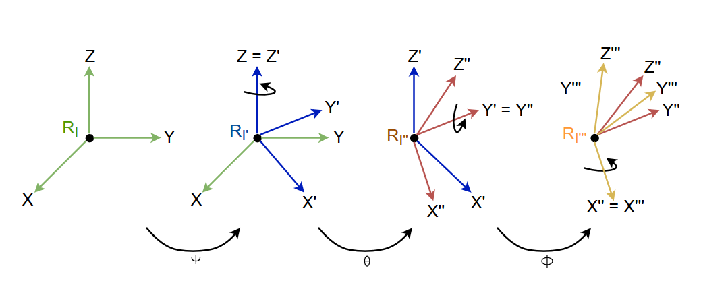
Dynamic model
Hypotheses:
Drone is symmetrically designed in form of “+”
Drag force on drone’s body is neglected
Newton Approach
Inertial reference = R_{I} and Body reference = R_{B}
Inertial matrix J
Euler angles type II: Z - Y’ - X’’

Slide 6
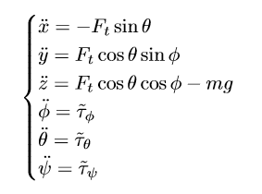
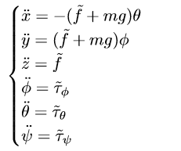

Dynamic model
𝜭 < 10°
𝝓 < 10°

Slide 7



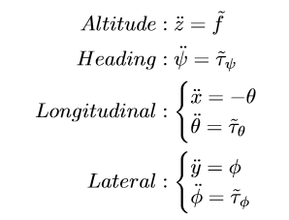



Controller
Nested saturations control

Slide 8
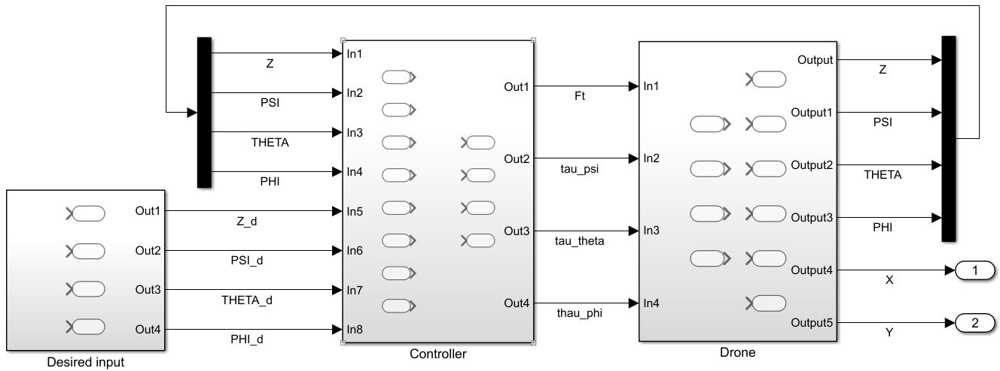
Controller

Slide 9
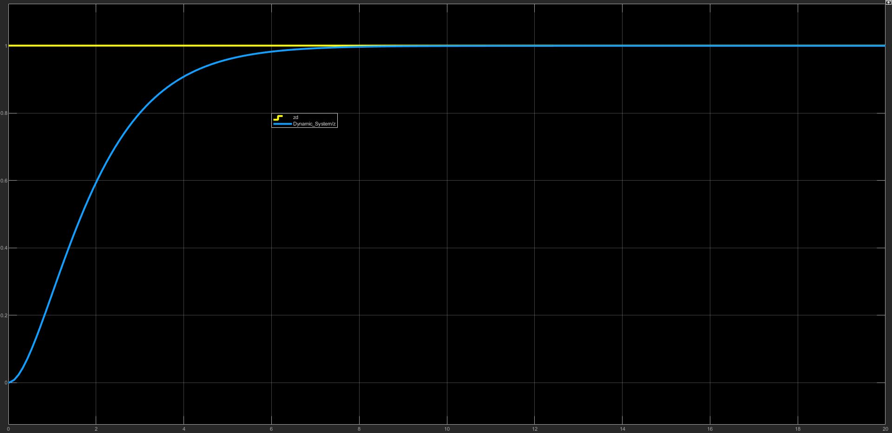
Controller
Control Z_{d} = 1 and convergence after 8s

Slide 10
Control a fleet of drones

Slide 11
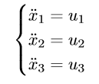
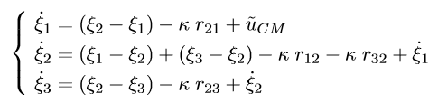


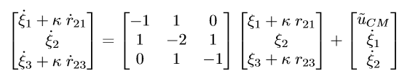
Formation control (double integrators)
Chain topology of 3 drones (1 is leader)
r₁₂ - r₃₂
r₃₂
1
3
2
States and control inputs
Exchange information between drones in chain topology system
Generic representation of “chain-topology system”
J.A. Guerrero, P. Castillo, Y. Challal. Trajectory tracking for a group of mini rotorcraft flying in formation. Springer, 2011.

Slide 12





Formation control (double integrators)
Proposition of controller:

Slide 13


Formation control (double integrators)
From drone dynamics
Integrate formation control to each drone

Slide 14
Simulation

Slide 15
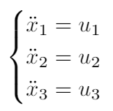
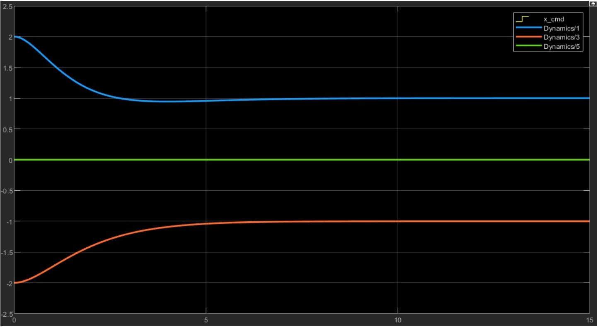
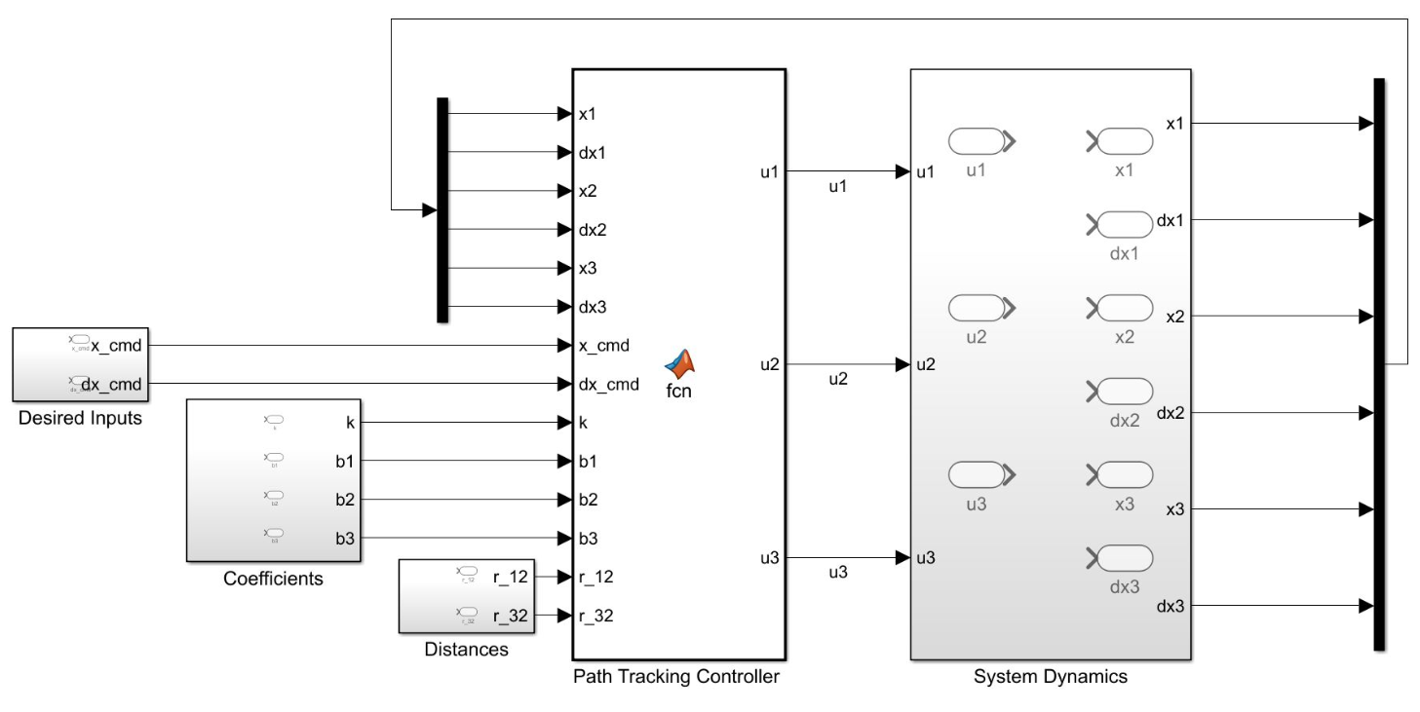
Simple fleet

Slide 16
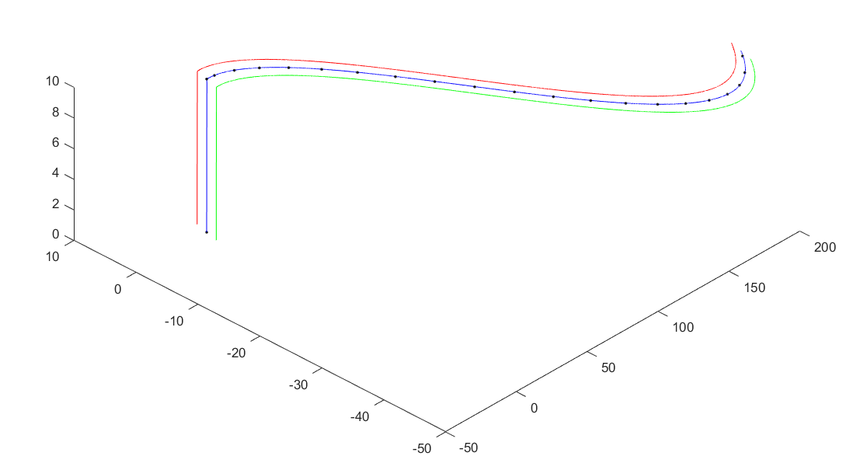
Path tracking : polynomial trajectory
First step: Control z and 𝜓 to get 10m of attitude
Second step: Track a polynomial trajectory by controlling (x, ፀ) and (y, φ)
In this project, we use a trajectory of polynomial of degree 3.

Slide 17
Conclusion & Discussion

Slide 18
Conclusion
Throughout this project, we have the opportunity to learn how to establish a real physical model, make possible hypothesis to simplify that system, and also apply the control technique studied in class to let the fleet of drones track a polynomial trajectory.
Beside making simulation, we demonstrated also the convergent properties of the used method.
As result, it turns out that our fleet track the trajectory with very high accuracy. This confirms the theoretical knowledge we saw in class.

Slide 19

Discussion
Small k: the center of mass of the fleet goes far from the predefined trajectory
Big k: the center of mass of the fleet well pursuits the trajectory but the system may fail if we continue to increase k

Slide 20
Thank you for your attention

